Slide 1
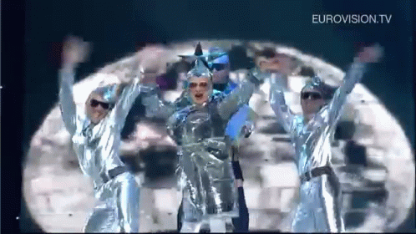
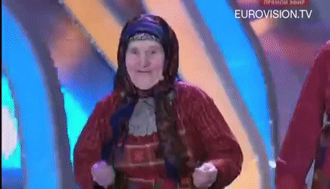

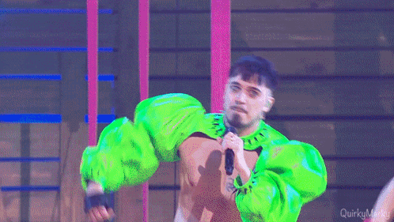


Slide 2
A geopolitical Analysis of the
Eurovision Song Contest Votes
Christopher Vogel - Data Analytics
Spiced color: #3f0097

Slide 3
Introduction to the ESC
How does voting work?
Why do I care?
Each country awards 1-8, 10, and 12 points
One set as jury vote
One set as televote
Since 2023 additional points from extra countries
Big discrepancies between my own perception and jury votes

Slide 4

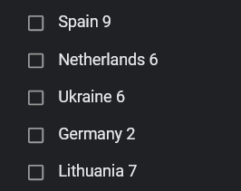
Ukraine 2022

Slide 5
How?

Slide 6
Who votes for who?

Slide 7
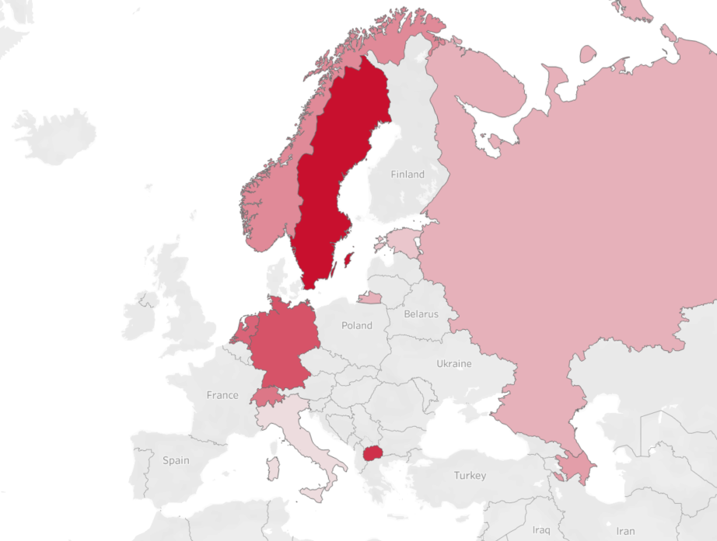
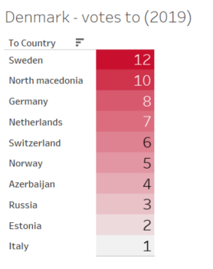

Slide 8
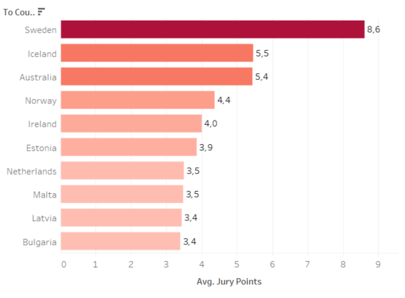

Slide 9
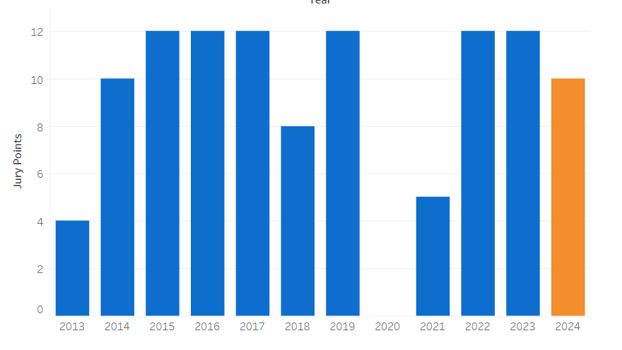

Slide 10
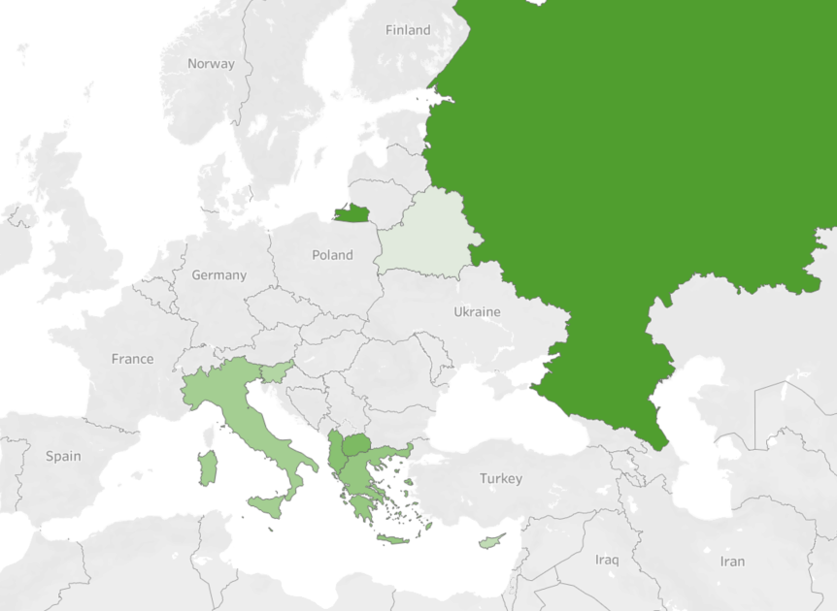
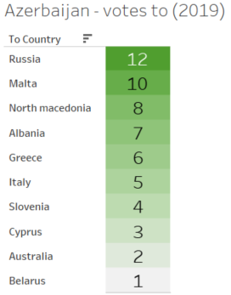


Slide 11
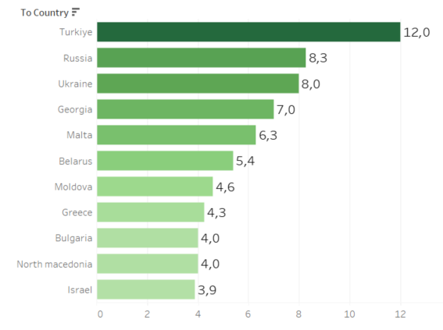

Slide 12
Who gets votes from whom?

Slide 13
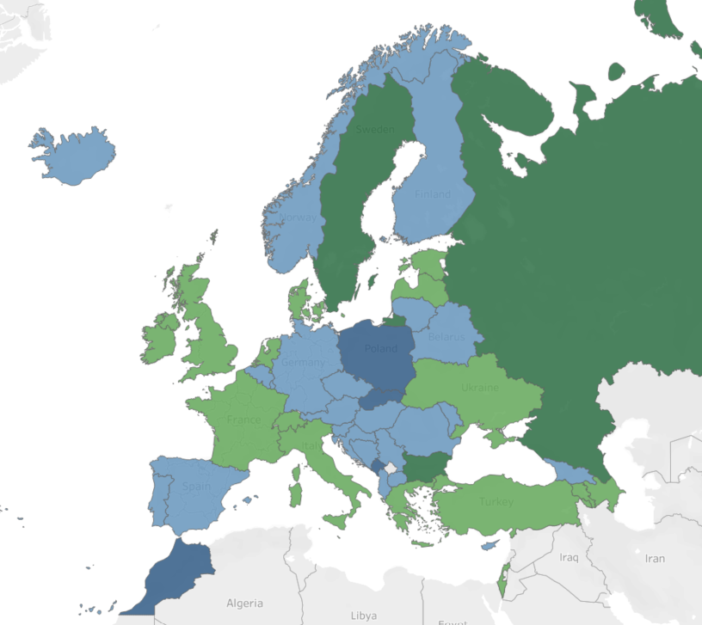
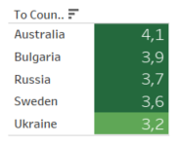
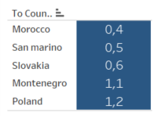
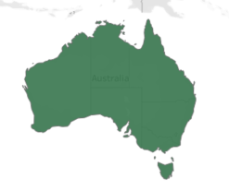

Slide 14
Potential Reasons
Political
Other
Political ties, lack thereof
Similar cultures
Geographic proximity
Statistical (how often have they participated?)
Big Five

Slide 15
Do Events affect Voting?

Slide 16
Correlation does not equal Causation!

Slide 17
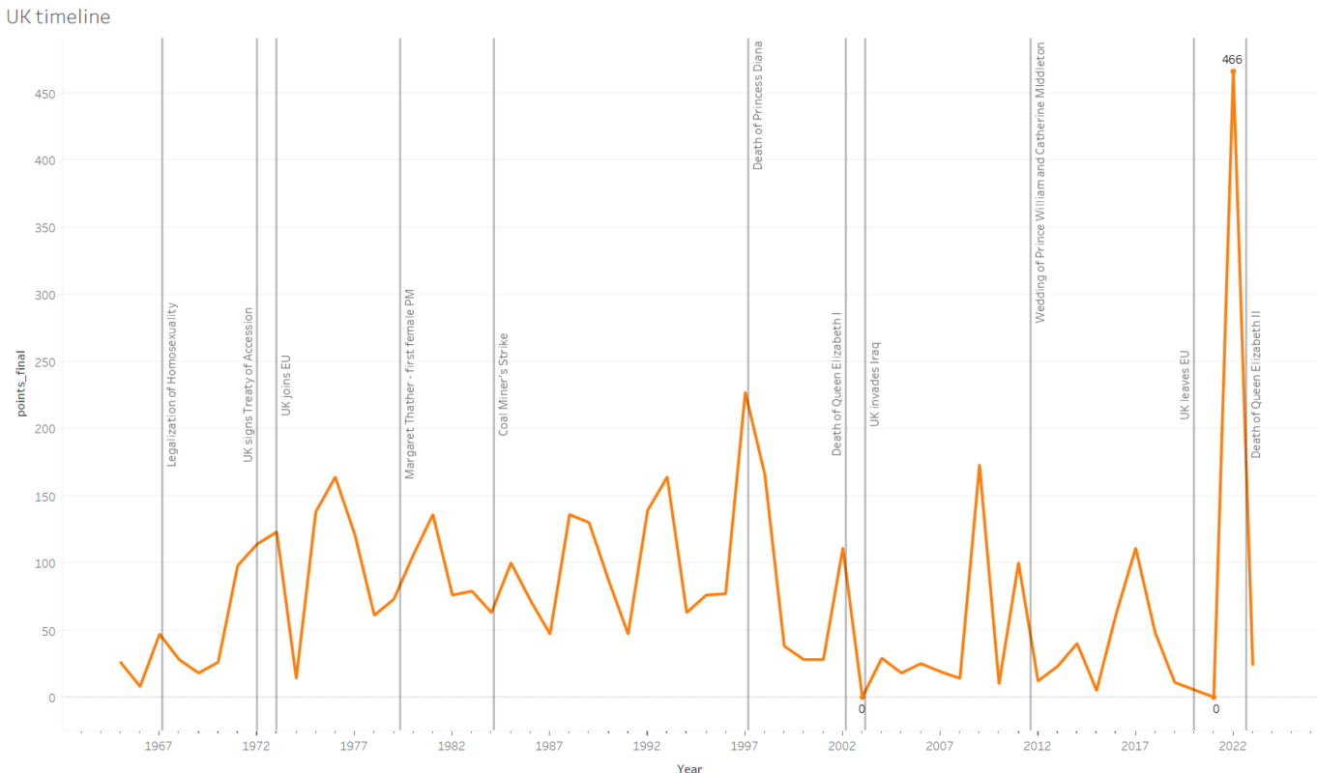

Slide 18
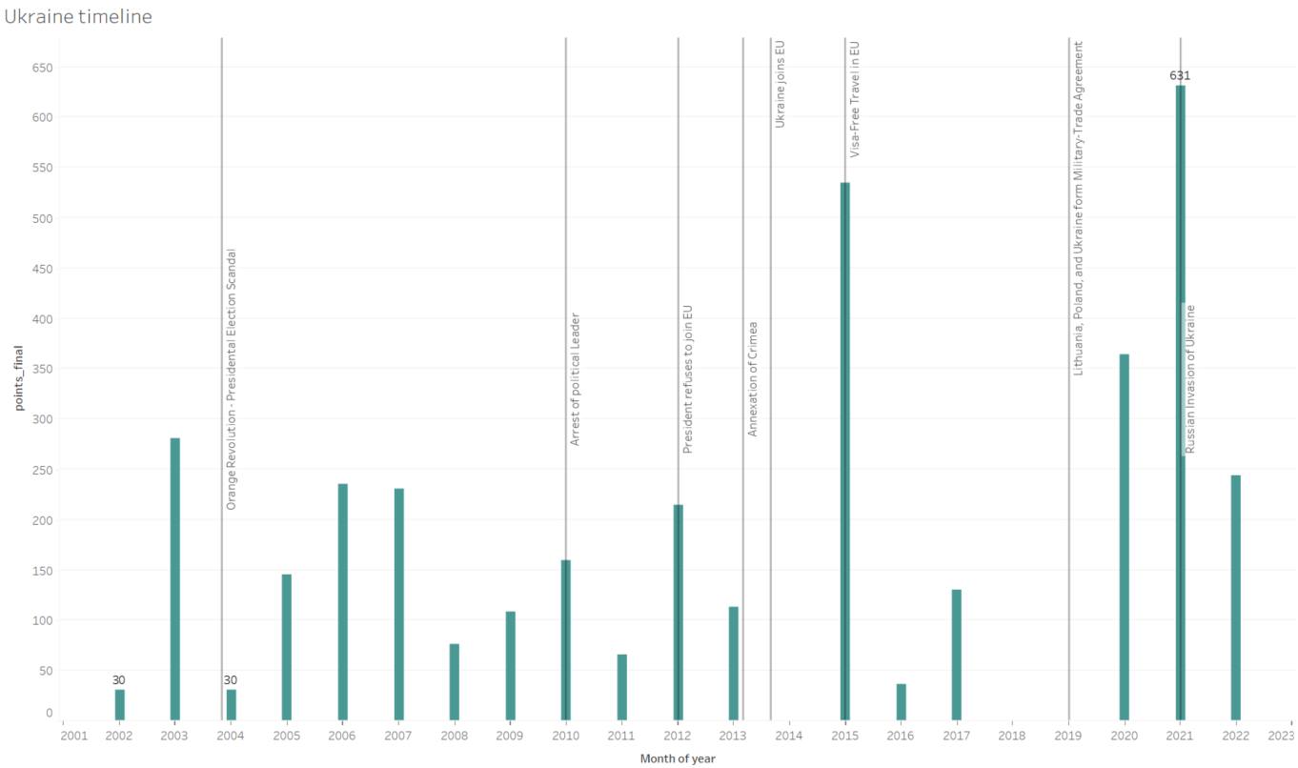

Slide 19
Conclusions

Slide 20
Thank You
Pesto Pandas Data
Cite data sources
More citations

